Slide 1
Project: Virtual Job Fair 2.0 Student: Luis Irizarry, Luis Benjumea, Jorge Fernandez Mentor: Juan Caraballo
Project Presentation
CIS 4911 Senior Project
School of Computing and Information Sciences
Florida International University
<12/09/13>

Slide 2
Problem Definition & Current Limitations
Problem Definition
Employers looking for talented graduates and vice versa
Distance and lack of resources
Current System
Greatly helps the problem
Limited to audiovisual contact
It has potential to resemble physical interview much more

Slide 3
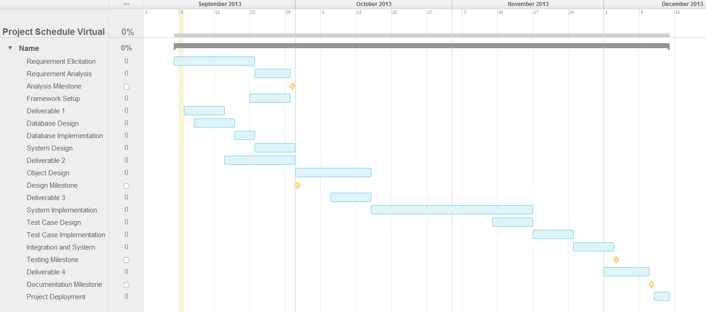
Schedule

Slide 4
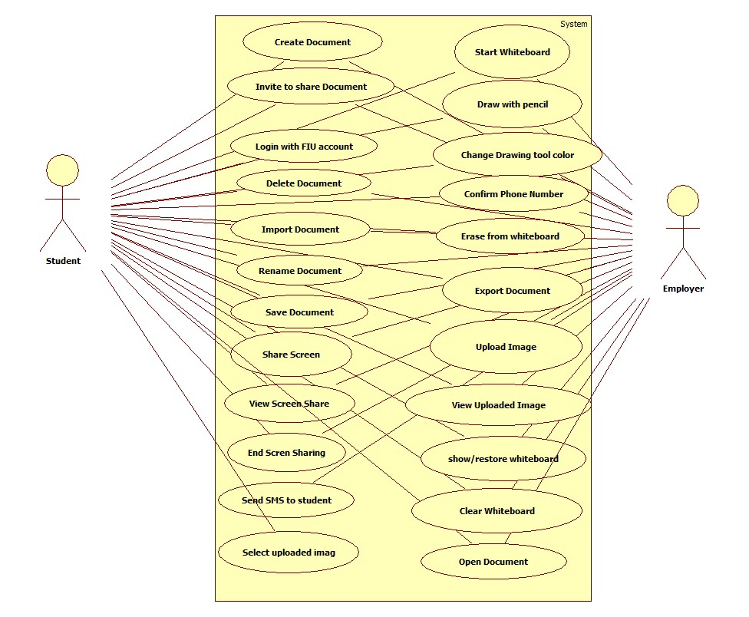
Use Case Diagram

Slide 5
Use Case ID VJF-058 Upload Image
Description Upload an image to the server during a live interview
Actor(s) Student or Employer
Preconditions
An interview session is active, whiteboard started and image pre-loaded
Steps
The user shall click on the “Submit Drawing” button on top of the whiteboard
The system shall upload the image
The system shall let the user know whether the image was uploaded successfully
Post-conditions
The file was successfully upload to the server and can be viewed by either user
Usability: simple as clicking the “Submit Drawing” button, making it simple to use
Reliability: Uploading images should work 99% of the time
Performance: Depending on its size, the maximum time it should take to upload an image should be 10 seconds
Supportability: The system be supported by Chrome version 29 or above

Slide 6
Use Case ID VJF-045 Send SMS to student
Description Allows Employer to send a text message to a student
Actor Employer
Preconditions
User is logged in
User is in the homepage
Student has phone number associated with his account
Student has allowed SMS contact
Steps
User clicks on send SMS
User is redirected to SMS page
User enters username of student to contact (Alphanumeric)
User enters message
User presses send
Post-conditions
Selected Student receives text message.
Success pop up is displayed
Usability: Sending an SMS should not take more than 15 seconds for a novice user.
Reliability: The system should perform correctly 99% of the time.
Performance: The SMS should be sent in under 2 seconds after user presses send
Supportability: Sending SMS page should be supported by Chrome version 29 or above

Slide 7

System Design MVC
1-HTTP Request
Yii Router
7-HTML
2-Action
5-Invoke
3-Call
View
Controller
Model
6-HTML
4-Send Content

Slide 8
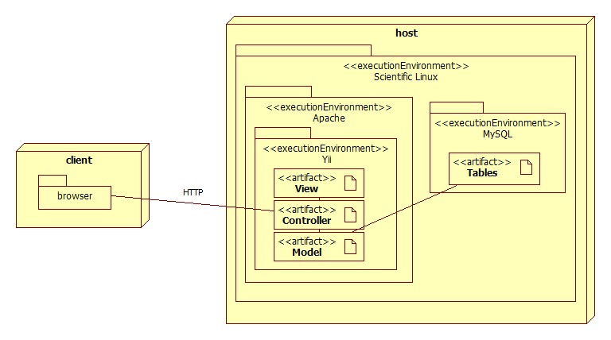
System Deployment

Slide 9
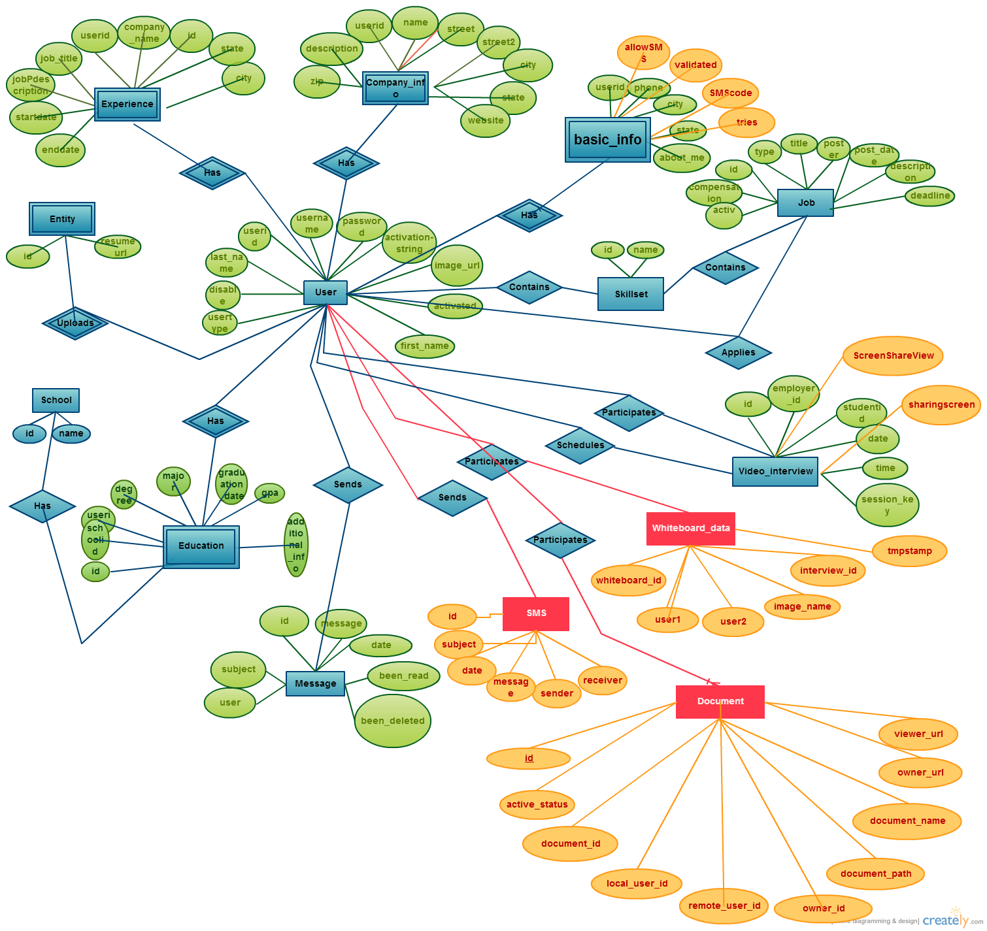
Database Design

Slide 10
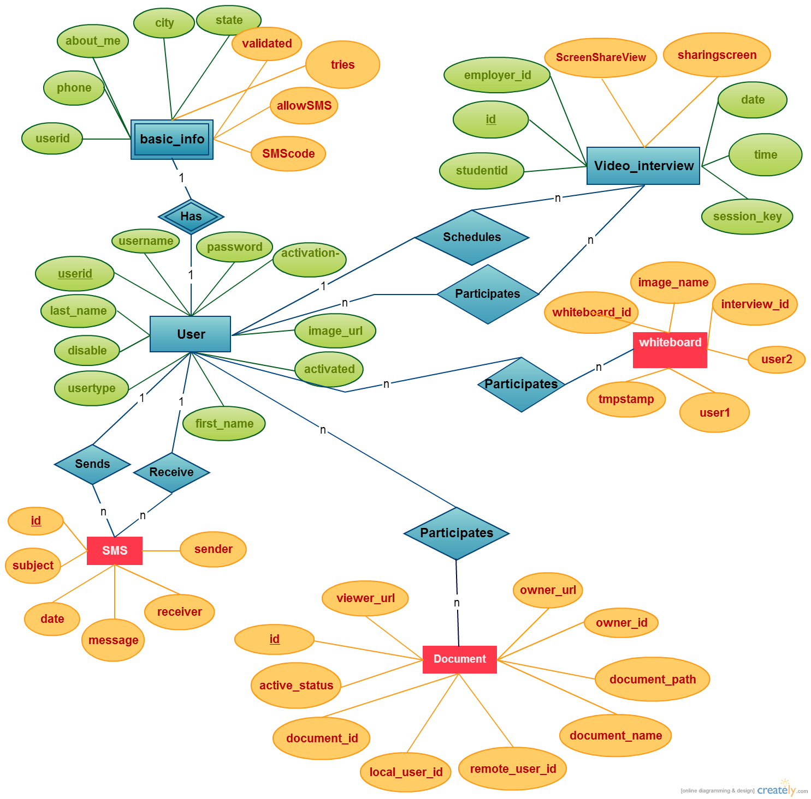
Database Design Detailed View

Slide 11
Security and Privacy
Privacy
Document repository hosted locally on FIU servers (Data is never sent to third parties).
Unix file permissions restrictions
Yii Access Control Rules restrictions
User may opt to hide contact information as well as be contacted by SMS
Security
User password will be hashed before it is stored in the database.
Cross-site Scripting Prevention
Per document/per session unique document access code
Users must validate their phones before using any SMS functionality

Slide 12
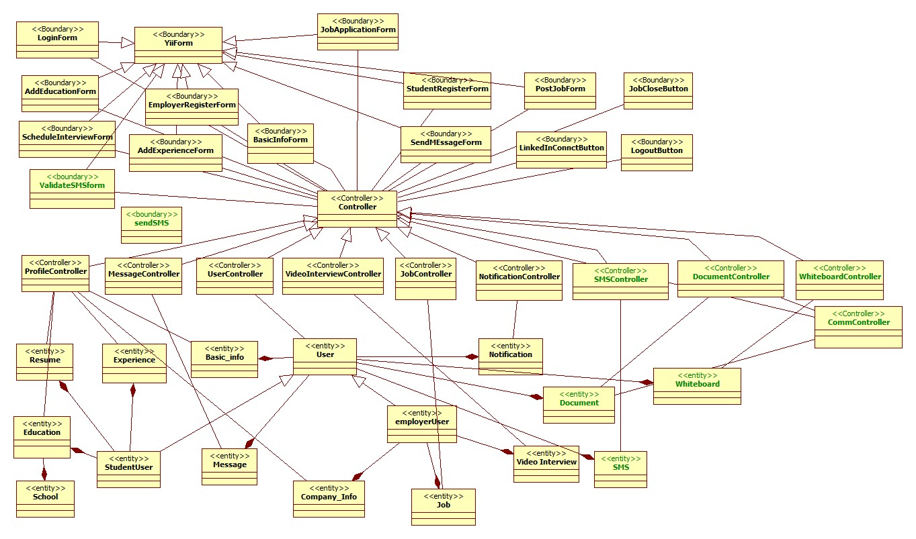
Class Diagram

Slide 13
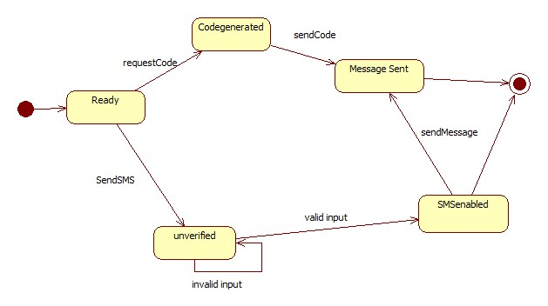
SMS State Machine

Slide 14
System Testing Sunny Day
Identifier VJF_SYSTEM_Send_SMS_TC01
Purpose
This test verifies that the System sends SMS message to the correct recipient
Preconditions
User is logged in as an employer
User has validated phone number
Student “JohnK” allows SMS messages
Input
User clicks on Send SMS
User enters “JohnK” as username
User enters “Hello John, I would like to talk to you!
User presses Send
Expected Output
Employer receives confirmation popup
JohnK receives SMS

Slide 15
System Testing Rainy Day
Identifier VJF_SYSTEM_Send_SMS_TC03
Purpose
This test verifies that the System correctly handles unexpected input
Preconditions
User is logged in as an employer
User has validated phone number
Input
User clicks on Send SMS
User enters “$%$JOHN” as username
User enters “Hello John, I would like to talk to you!
User presses Send
Expected Output
“User does not exist”

